Slide 1
Declarative Transfer Learning from Deep CNNs at Scale
Supun Nakandala and Arun Kumar
{snakanda, arunkk}@eng.ucsd.edu

Slide 2
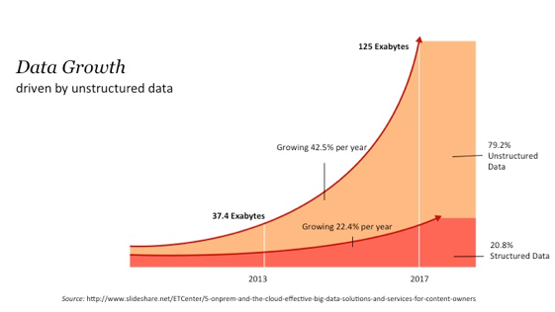
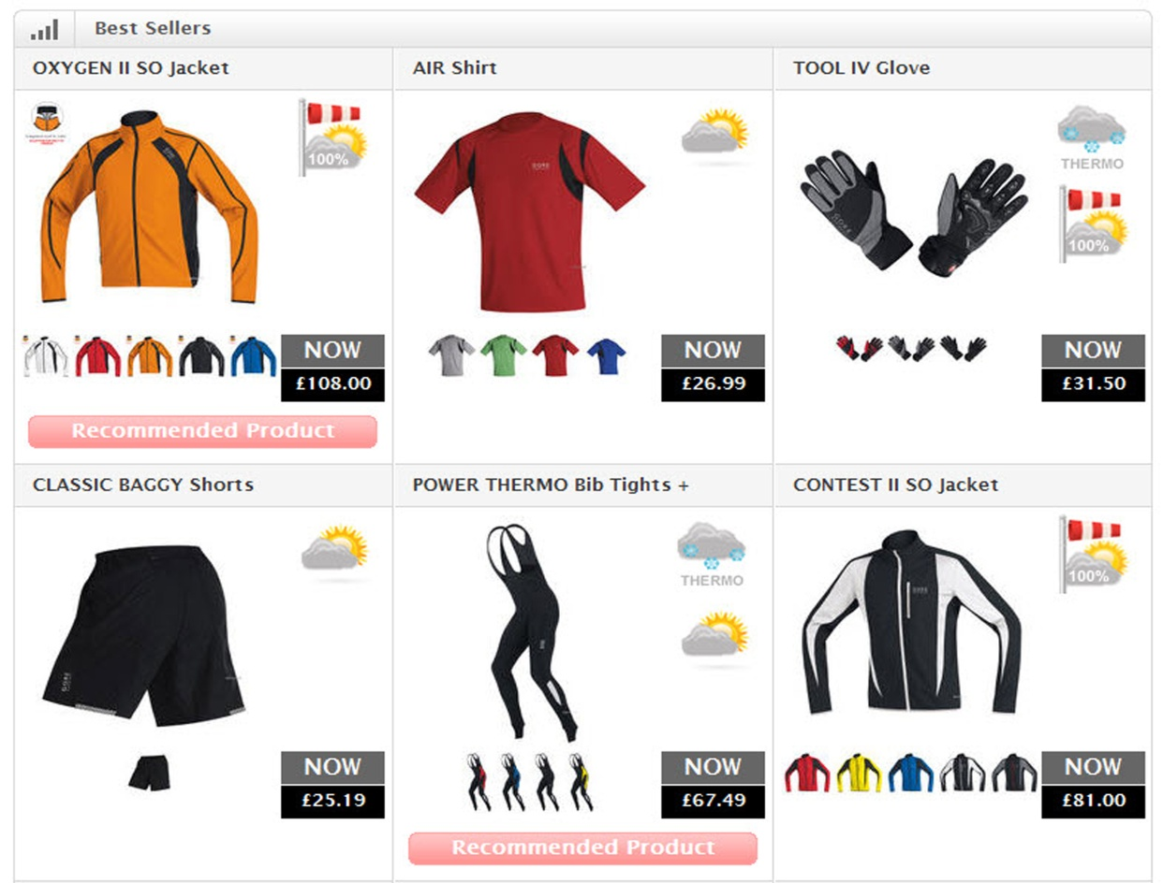
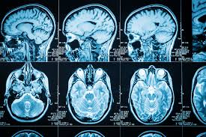
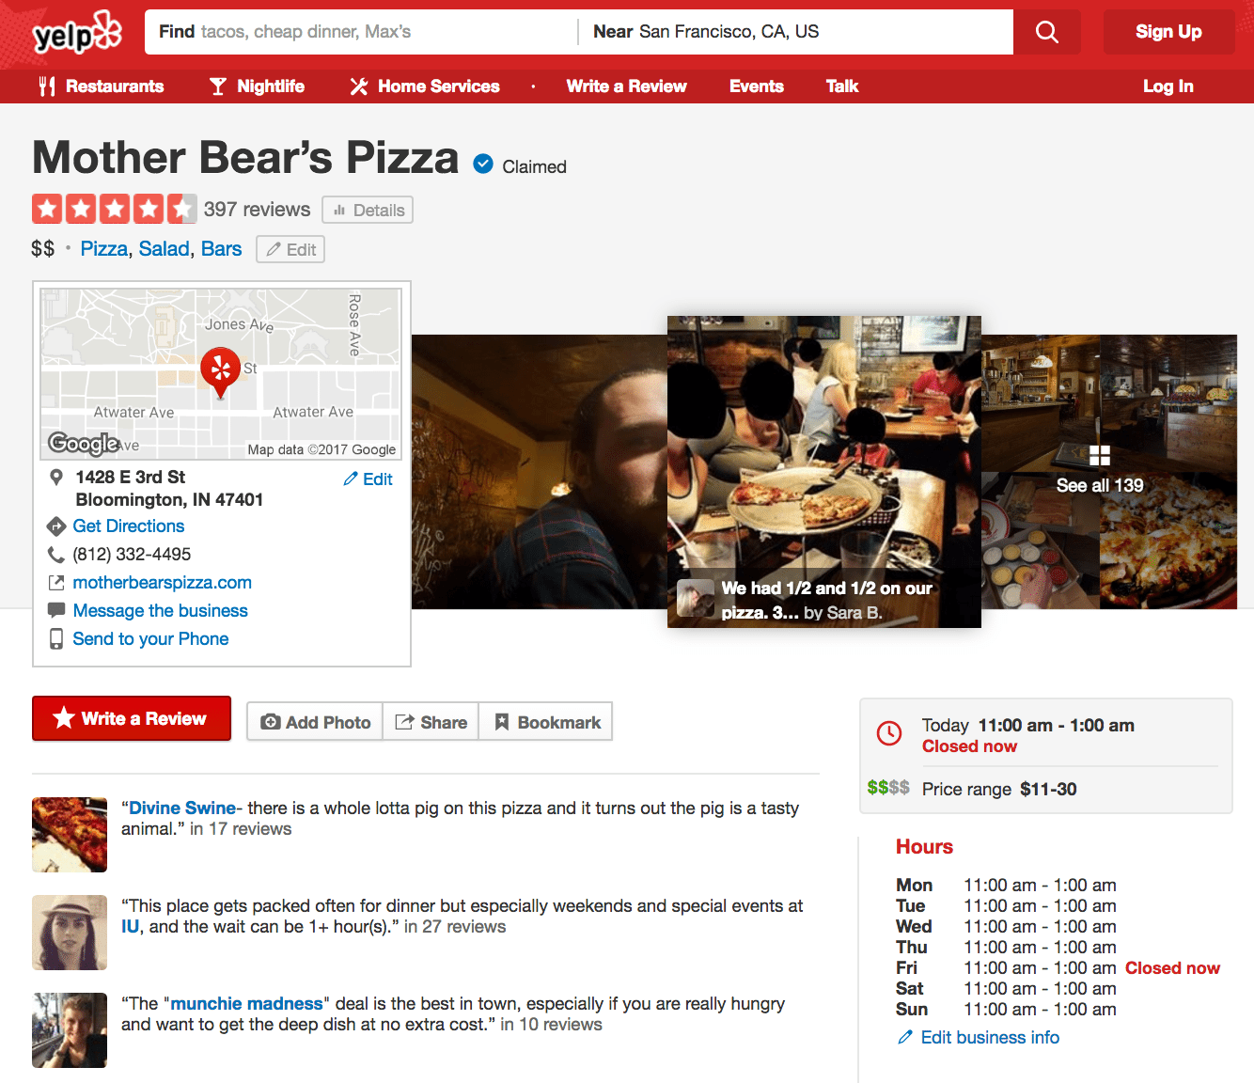
Growth of unstructured data
Data growth mainly driven by
unstructured data
Dark Data
unstructured
structured
Source: ETC@USC
Source: 2017 Kaggle Survey
e-Commerce
Healthcare
Social Media
2

Slide 3
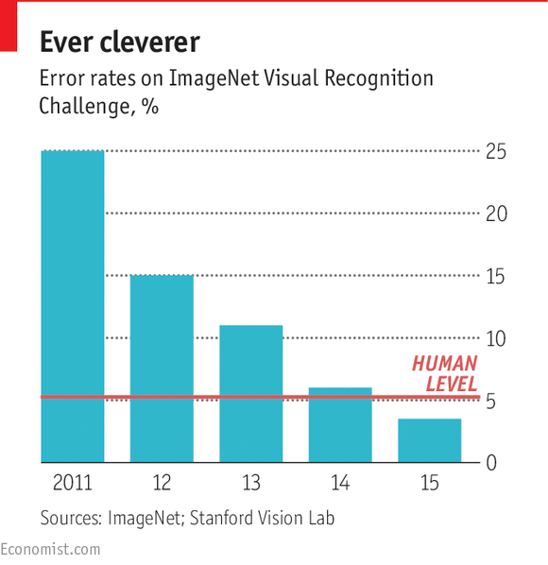
Opportunity: CNN
Deep Convolution Neural Networks (CNN) provide opportunities to holistically integrate image data with analytics pipelines.

Slide 4
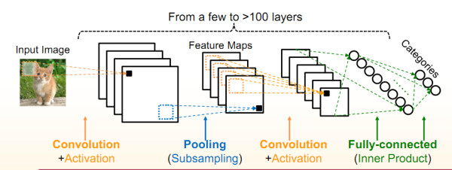
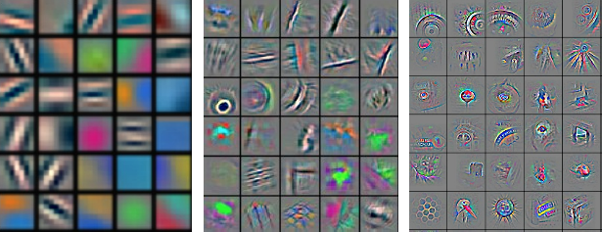
CNN: Hierarchical Feature Extractors
Low level features
Mid level features
High level features

Slide 5
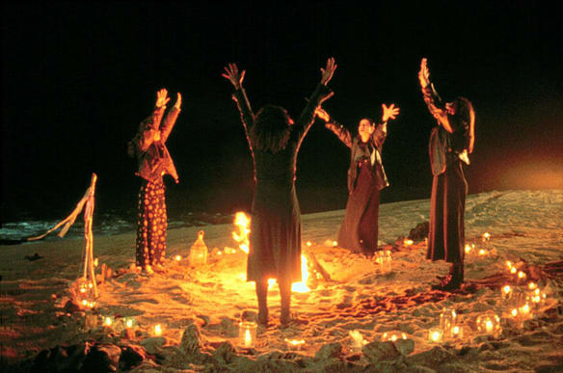
CNN: Training Limitations
“Transfer Learning” mitigates
these limitations
Lot of labelled training data
Lot of compute power
Time consuming
“Dark art” of hyperparameter tuning

Slide 6
Outline
Example and Motivations
Our System Vista
Experimental Evaluation

Slide 7
Transfer Learning: CNNs for the other 90%
Pre-trained CNN
Image Data
Train ML Model
Brand | Tags | Price
Evaluate
Structured Data

Slide 8
Transfer Learning: Bottleneck
Which layer will result in the best accuracy?
Image Data
Train ML Model
Brand | Tags | Price
Evaluate
Structured Data

Slide 9
Transfer Learning: Current Practice
+ Efficient CNN inference
- Doesn’t support scalable
processing
Image Data
+ Scalable processing
+ Fault tolerant
- No support for CNNs
Train ML Model
Brand | Tags | Price
Evaluate
Structured Data

Slide 10
Problems with Current Practice
Usability: Manual management of CNN features.
Efficiency: From image inference for all feature layers has computational redundancies.
Reliability: CNN layers are big, requires careful memory configuration.
Disk spills
System crashes!
l1
l2
l3

Slide 11
Outline
Example and Motivations
Our System Vista
Overview
System Architecture
System Optimizations
Experimental Evaluation

Slide 12
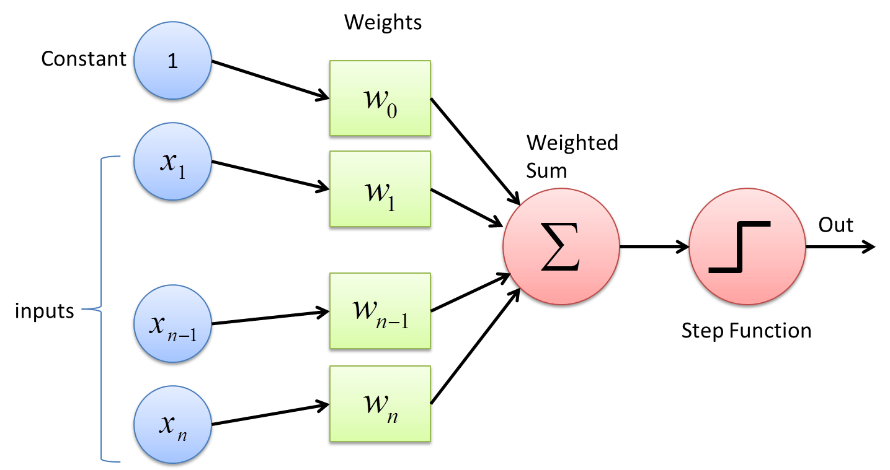
Vista: Overview
Vista is a declarative system for scalable feature transfer from
deep CNNs for multimodal analytics.
Vista takes in:
Brand | Tags | Price
l1
l2
l3
Structured Data
Image Data
Pre-trained CNN and layers of
interest
ML model
Vista optimizes the CNN feature transfer workload and reliably
runs it.

Slide 13
Outline
Example and Motivations
Our System Vista
Overview
System Architecture
System Optimizations
Experimental Evaluation

Slide 14
Vista: Architecture
Benefit: Usability
Declarative API
Pre-trained
CNNs
Optimizer
Logical Plan Optimizations
Benefit: Efficiency and Reliability
Physical Plan Optimizations
System Configuration Optimizations
Benefit: Efficiency, Scalability, and Fault Tolerance

Slide 15
Outline
Our System Vista
System Optimizations
Logical Plan Optimizations
Physical Plan Optimizations
System Configuration Optimizations

Slide 16
Current Practice: Repeated Inference
ML Model
Lazy Materialization
Problem: Repeated inferences
Multimodal Features {S, l1}
$$⋈$$
Structured Data {S}
Image Features {l1}
l1
l2
l3
Images

Slide 17
Extract all layers in one go
ML Model
ML Model
ML Model
Eager Materialization
{S, l1}
{S, l2}
{S, l3}
Problem: High Memory Footprint
- disk spills/cache misses
- system crashes!
Multimodal Features {S, l1, l2, l3}
$$⋈$$
Structured Data {S}
Image Features {l1, l2, l3}
l1
l2
l3
Images

Slide 18
Our Novel Plan: Staged CNN Inference
ML Model
ML Model
Partial CNN Operator
Multimodal Features {S, l1}
Multimodal Features
{S, l2}
l1
l2
l3
$$⋈$$
Staged Materialization
Structured Data {S}
Image Features {l1}
Benefits: No redundant computations, minimum memory footprint
l1
l2
l3
Images

Slide 19
Our Novel Plan: Staged CNN Inference
ML Model
ML Model
Partial CNN Operator
Multimodal Features {S, l1}
Multimodal Features
{S, l2}
l1
l2
l3
$$⋈$$
Staged Materialization
784 KB
Structured Data {S}
Image Features {l1}
Benefits: No redundant computations, minimum memory footprint
l1
l2
l3
14 KB
Images
Problem: High join overhead

Slide 20
Our Novel Plan: Staged CNN Inference - Reordered
ML Model
ML Model
Partial CNN Operator
Multimodal Features {S, l1}
Multimodal Features
{S, l2}
l1
l2
l3
$$⋈$$
Staged Materialization
Structured Data {S}
Image Features {l1}
Benefits: No redundant computations, minimum memory footprint
l1
l2
l3
Images
Problem: High join overhead

Slide 21
Outline
Our System Vista
System Optimizations
Logical Plan Optimizations
Physical Plan Optimizations
System Configuration Optimizations

Slide 22
Vista: Physical Plan Optimizations
Join Operator
Options: Broadcast vs Shuffle join
Trade-Offs: Memory footprint vs Network cost
Storage Format
Options: Compressed vs Uncompressed
Trade-Offs: Memory footprint vs Compute cost
Benefit: Vista automatically picks the physical plan choices.

Slide 23
Outline
Our System Vista
System Optimizations
Logical Plan Optimizations
Physical Plan Optimizations
System Configuration Optimizations

Slide 24
Vista: System Configuration Optimizations
Memory allocation
Query parallelism
Data partition size

Slide 25
Memory Allocation
Challenge: Default configurations won’t work
CNN features are big
Non trivial CNN model inference memory
Query Processing
e.g. join processing
UDF Execution
Store intermediate data
CNN model footprints
OS Reserved
Memory
User
Memory
Core
Memory
In-Memory
Storage
CNN Inference
Memory
Benefit: Vista frees the data scientist from manual memory
and system configuration tuning.

Slide 26
Query Parallelism and Data Partition Size
Query Parallelism
Increase Query Parallelism → Increase CNN Inference Memory → Less Storage Memory
Benefit: Vista sets Query Parallelism to improve utilization and reduce disk spills.
Data Partition Size
Too big → System Crash, Too small → High overhead
Benefit: Vista sets optimal data partition size to reduce overheads and avoid crashes.

Slide 27
Outline
Example and Motivations
Our System Vista
Experimental Evaluation

Slide 28
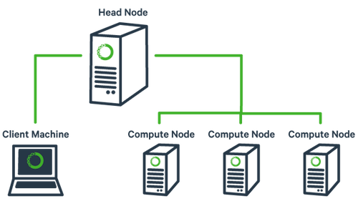
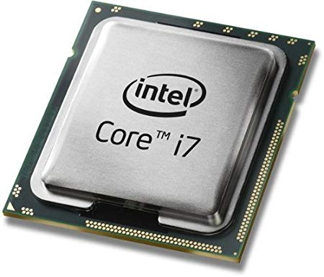
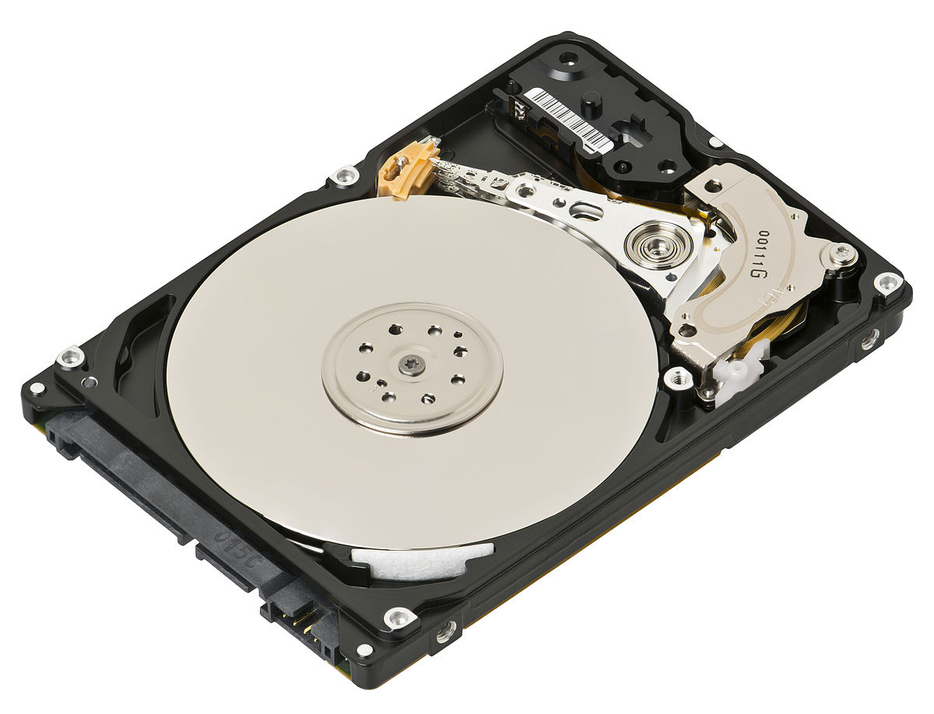
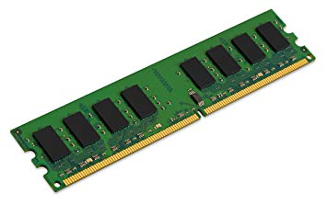
Experimental Setup
Intel Xeon @ 2.00GHz CPU with 8 cores
8 worker nodes
and 1 master node
300 GB HDD
32 GB RAM
Version 2.2.0
Runs in standalone mode
Version 1.3.0

Slide 29
Dataset & Workloads
Amazon product reviews dataset
Number of Records | 200,000
Number of Structured Features | 200 – price, category embedding, review embedding
Image | Image of each product item
Target | Predict each product is popular or not
Pre-trained CNNs:
ML model:
AlexNet – Last 4 layers
Logistic Regression for 10 iterations
VGG16 – Last 3 layers
ResNet50 – Last 5 layers

Slide 30
End-to-end reliability and efficiency
System crashes due
to mismanaged
memory
Runtime (min)
10X
X System crashes
Experimental results for other data systems, datasets, and drill-down experiments can be found in our paper.

Slide 31
Summary of Vista
Declarative system for scalable feature transfer from CNNs.
Performs DBMS inspired logical plan, physical plan, and system configuration optimizations.
Improves efficiency by up to 90% and avoids unexpected system crashes.
Thank You!
Project Webpage: https://adalabucsd.github.io/vista.html

